Slide 1

Global Environmental Politics
by Jean-Frédéric Morin, Amandine Orsini and Sikina Jinnah

Slide 2
Part 03
Bargaining over the environment
Chapter 05
The tragedy of the commons and sovereign rights

Slide 3
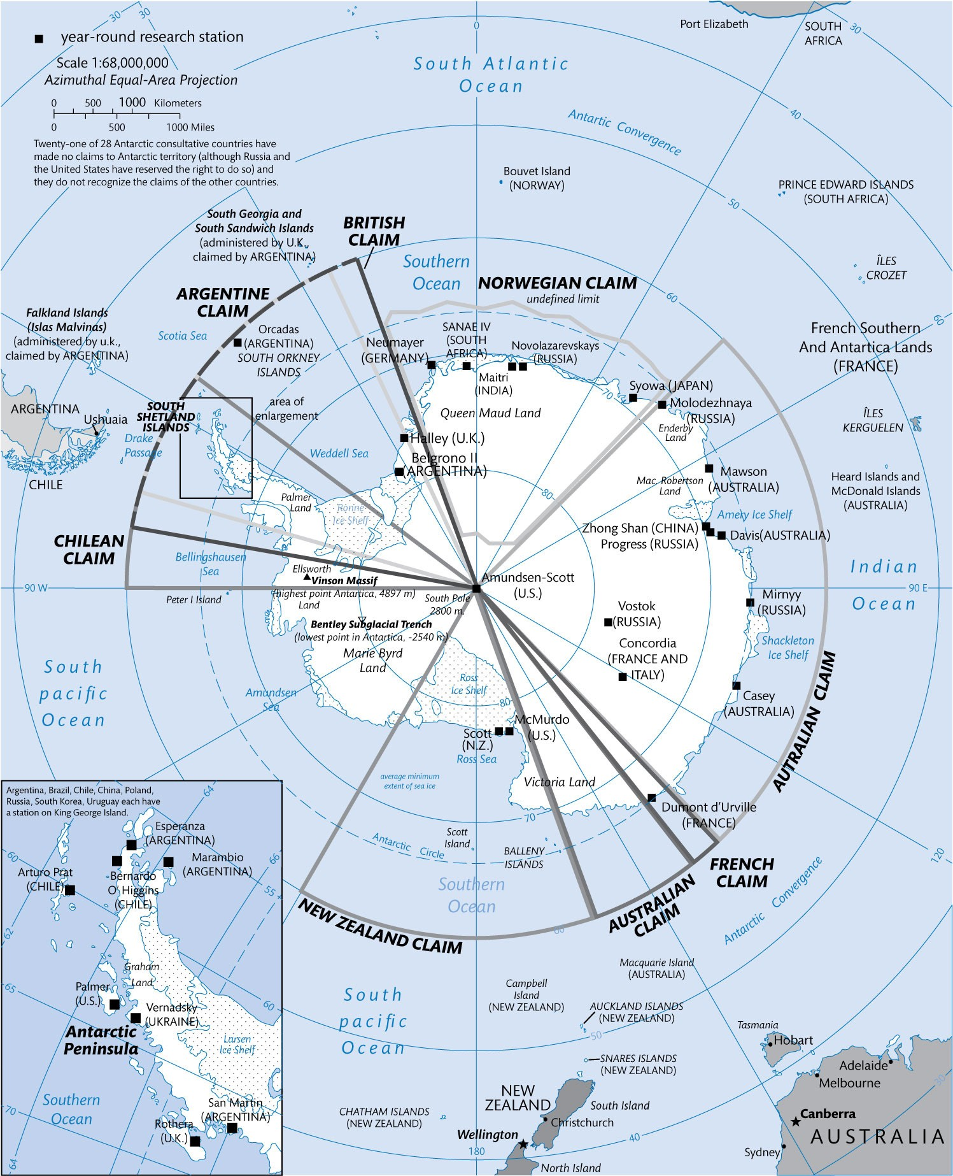
Figure 5.1 Territorial claims in Antarctica

Slide 4
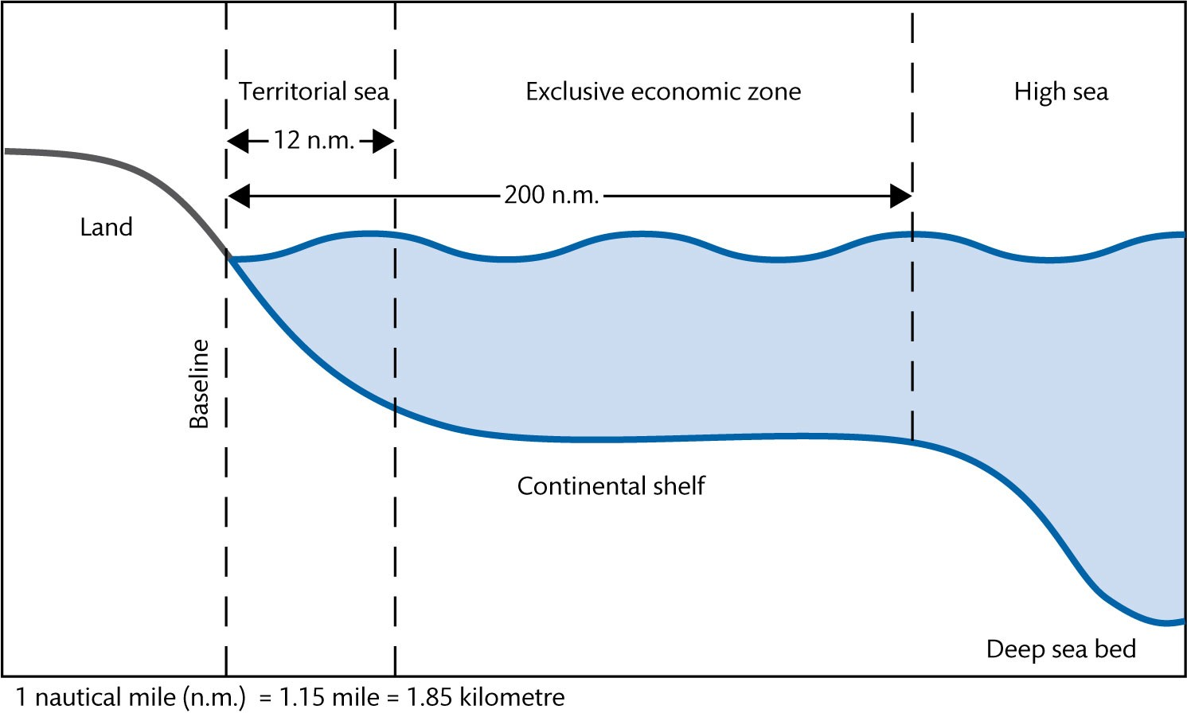
Figure 5.2 Coastal state zones

Slide 5
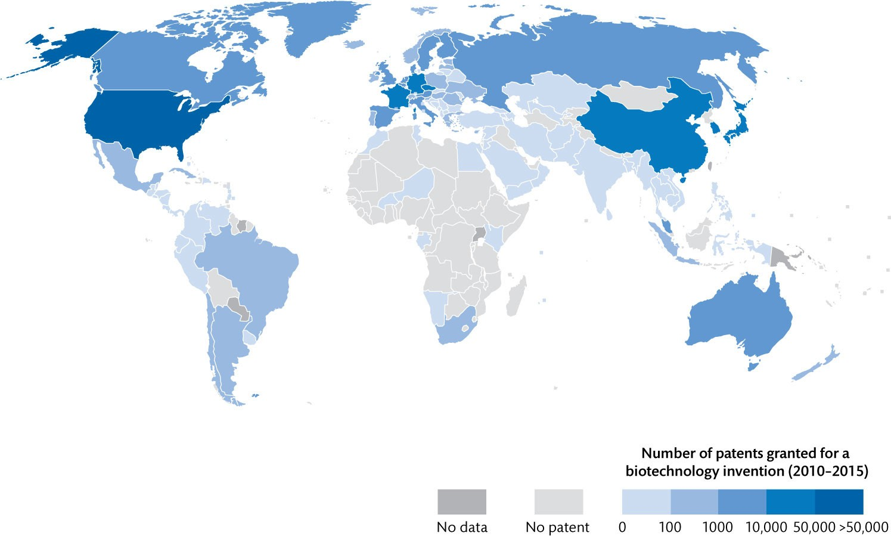
Figure 5.3 Distribution of biotechnology capacities (2010–2015)

Slide 6
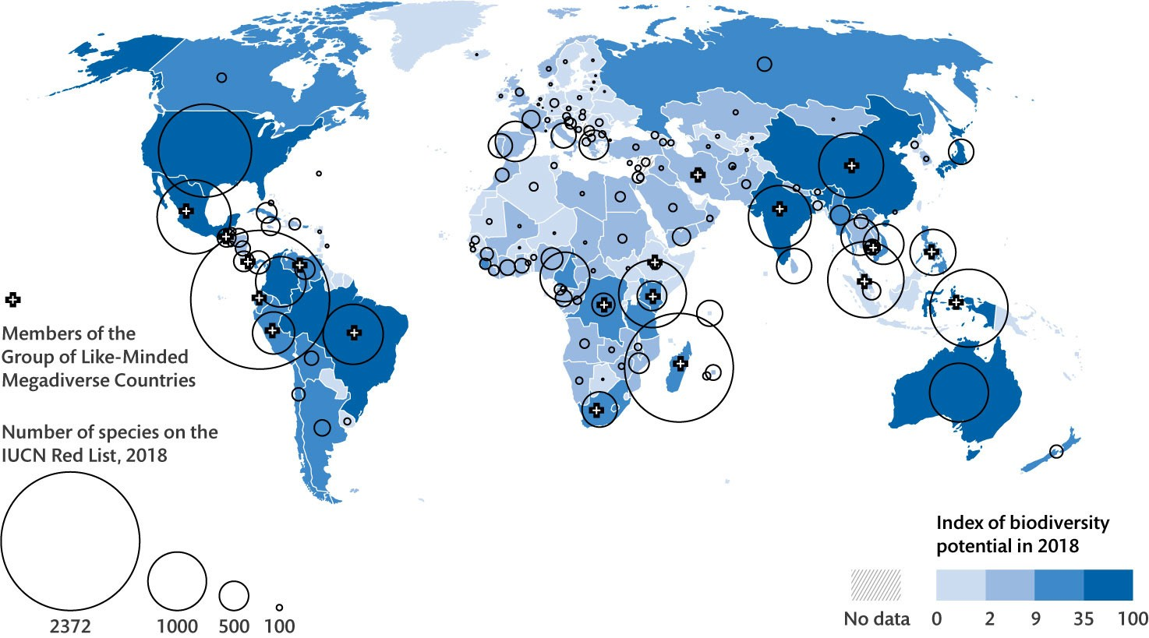
Figure 5.4 Distribution of biological diversity (2018)

Slide 7
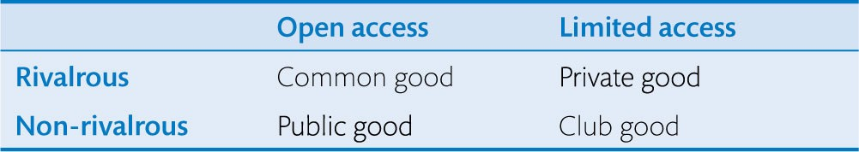
Table 5.1 Typology of goods

Slide 8
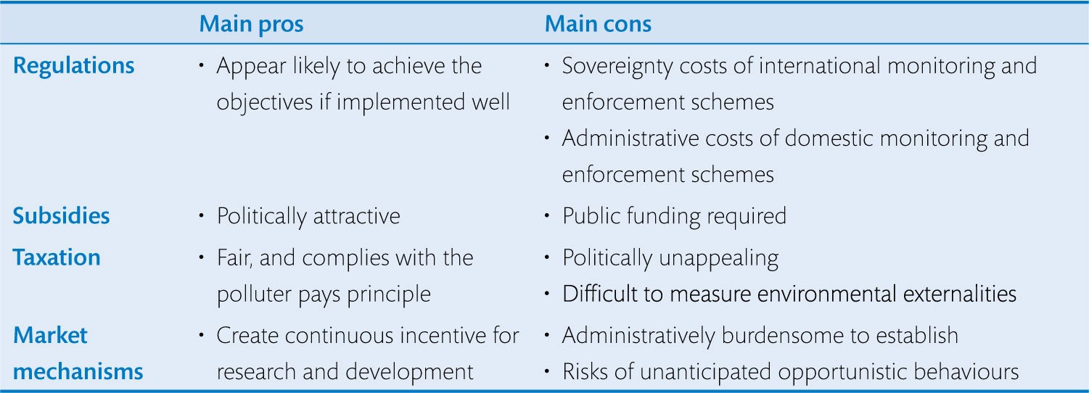
Table 5.2 Four solutions to the tragedy of the commons

Slide 9
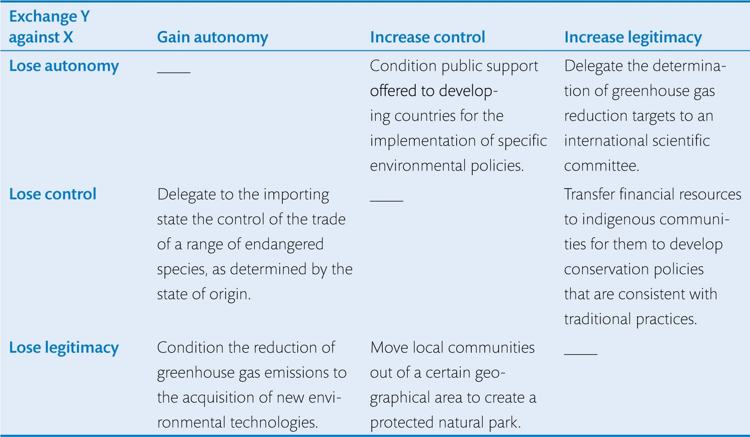
Table 5.3 The sovereignty trade-off

