Slide 1
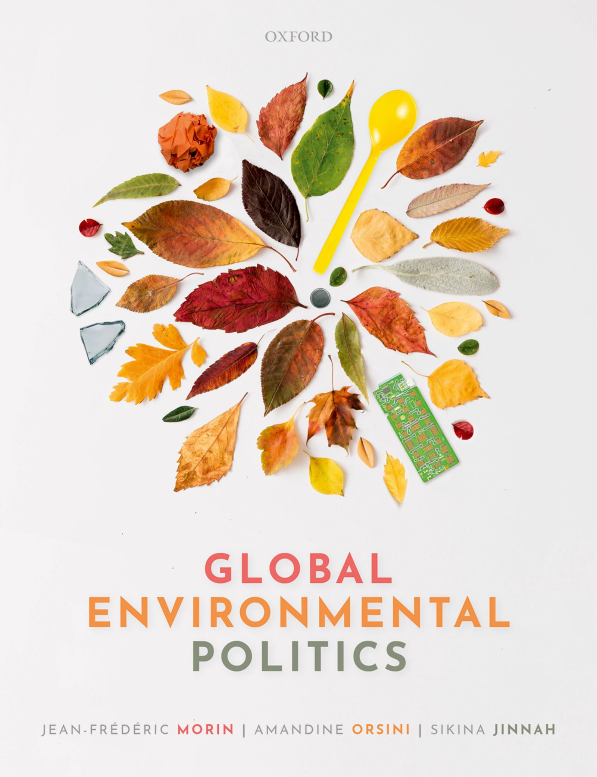
Global Environmental Politics
by Jean-Frédéric Morin, Amandine Orsini and Sikina Jinnah

Slide 2
Introduction

Slide 3
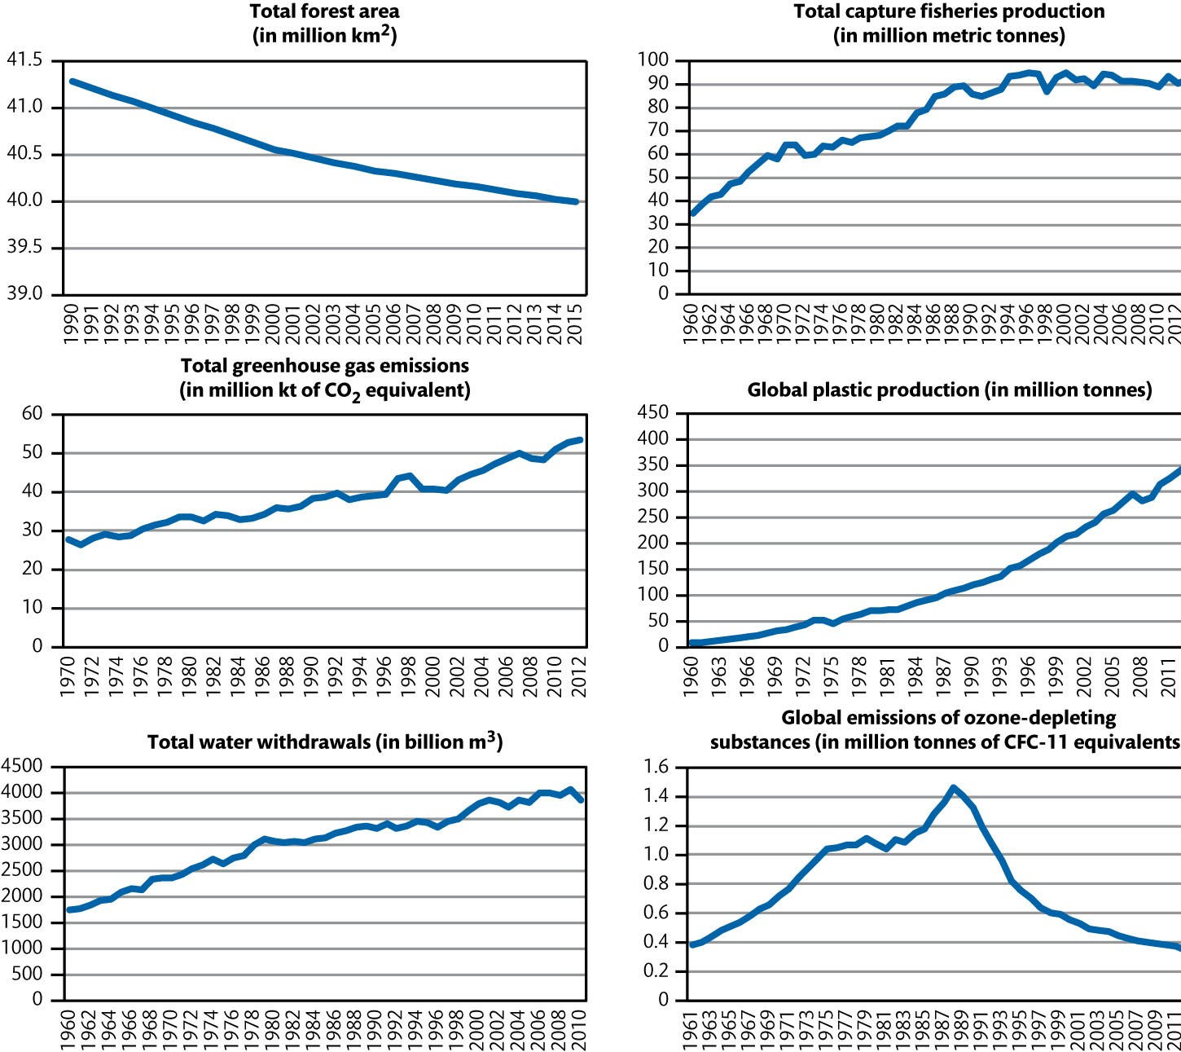
Figure 0.1 Global trends in environmental degradation

Slide 4
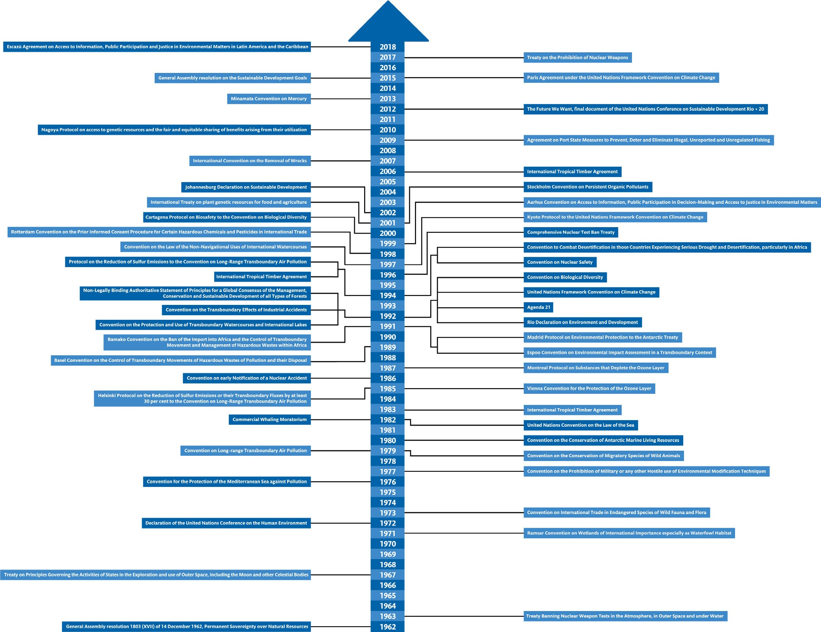
Figure 0.2 Timeline of the main treaties and declarations

Slide 5
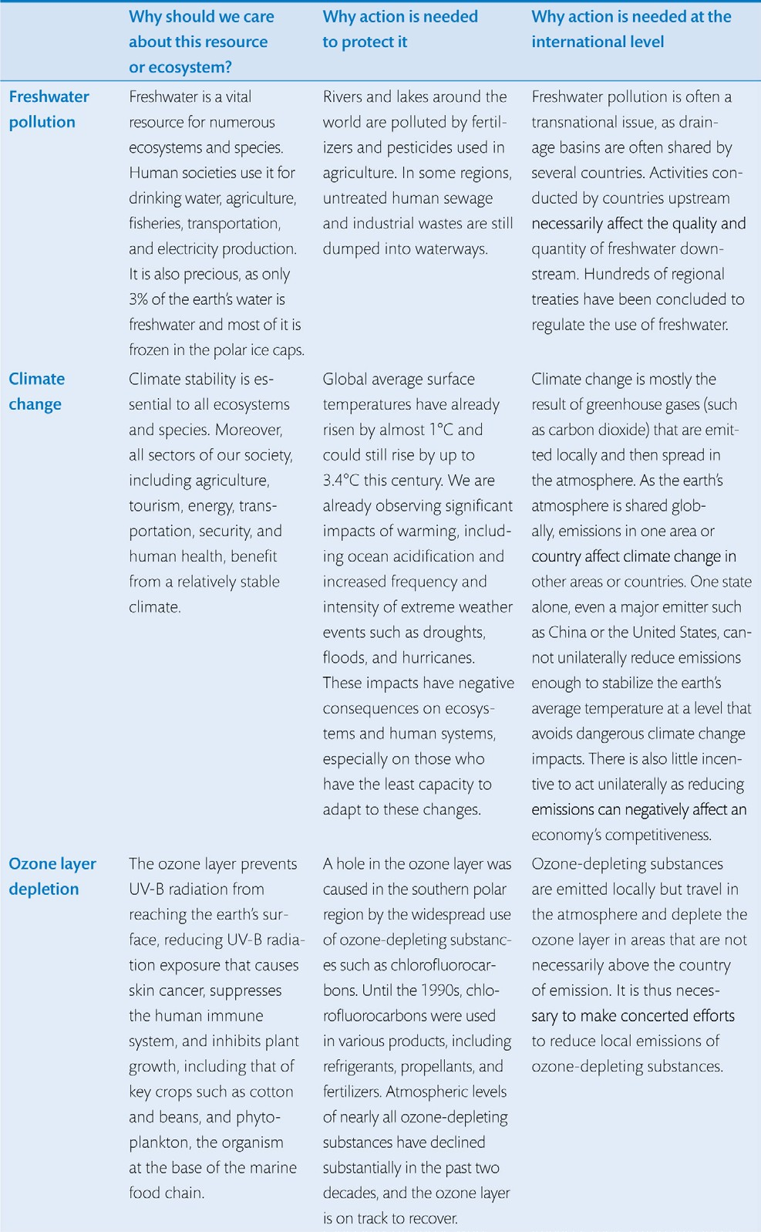
Table 0.1 Selected international environmental issues (Continued)

Slide 6
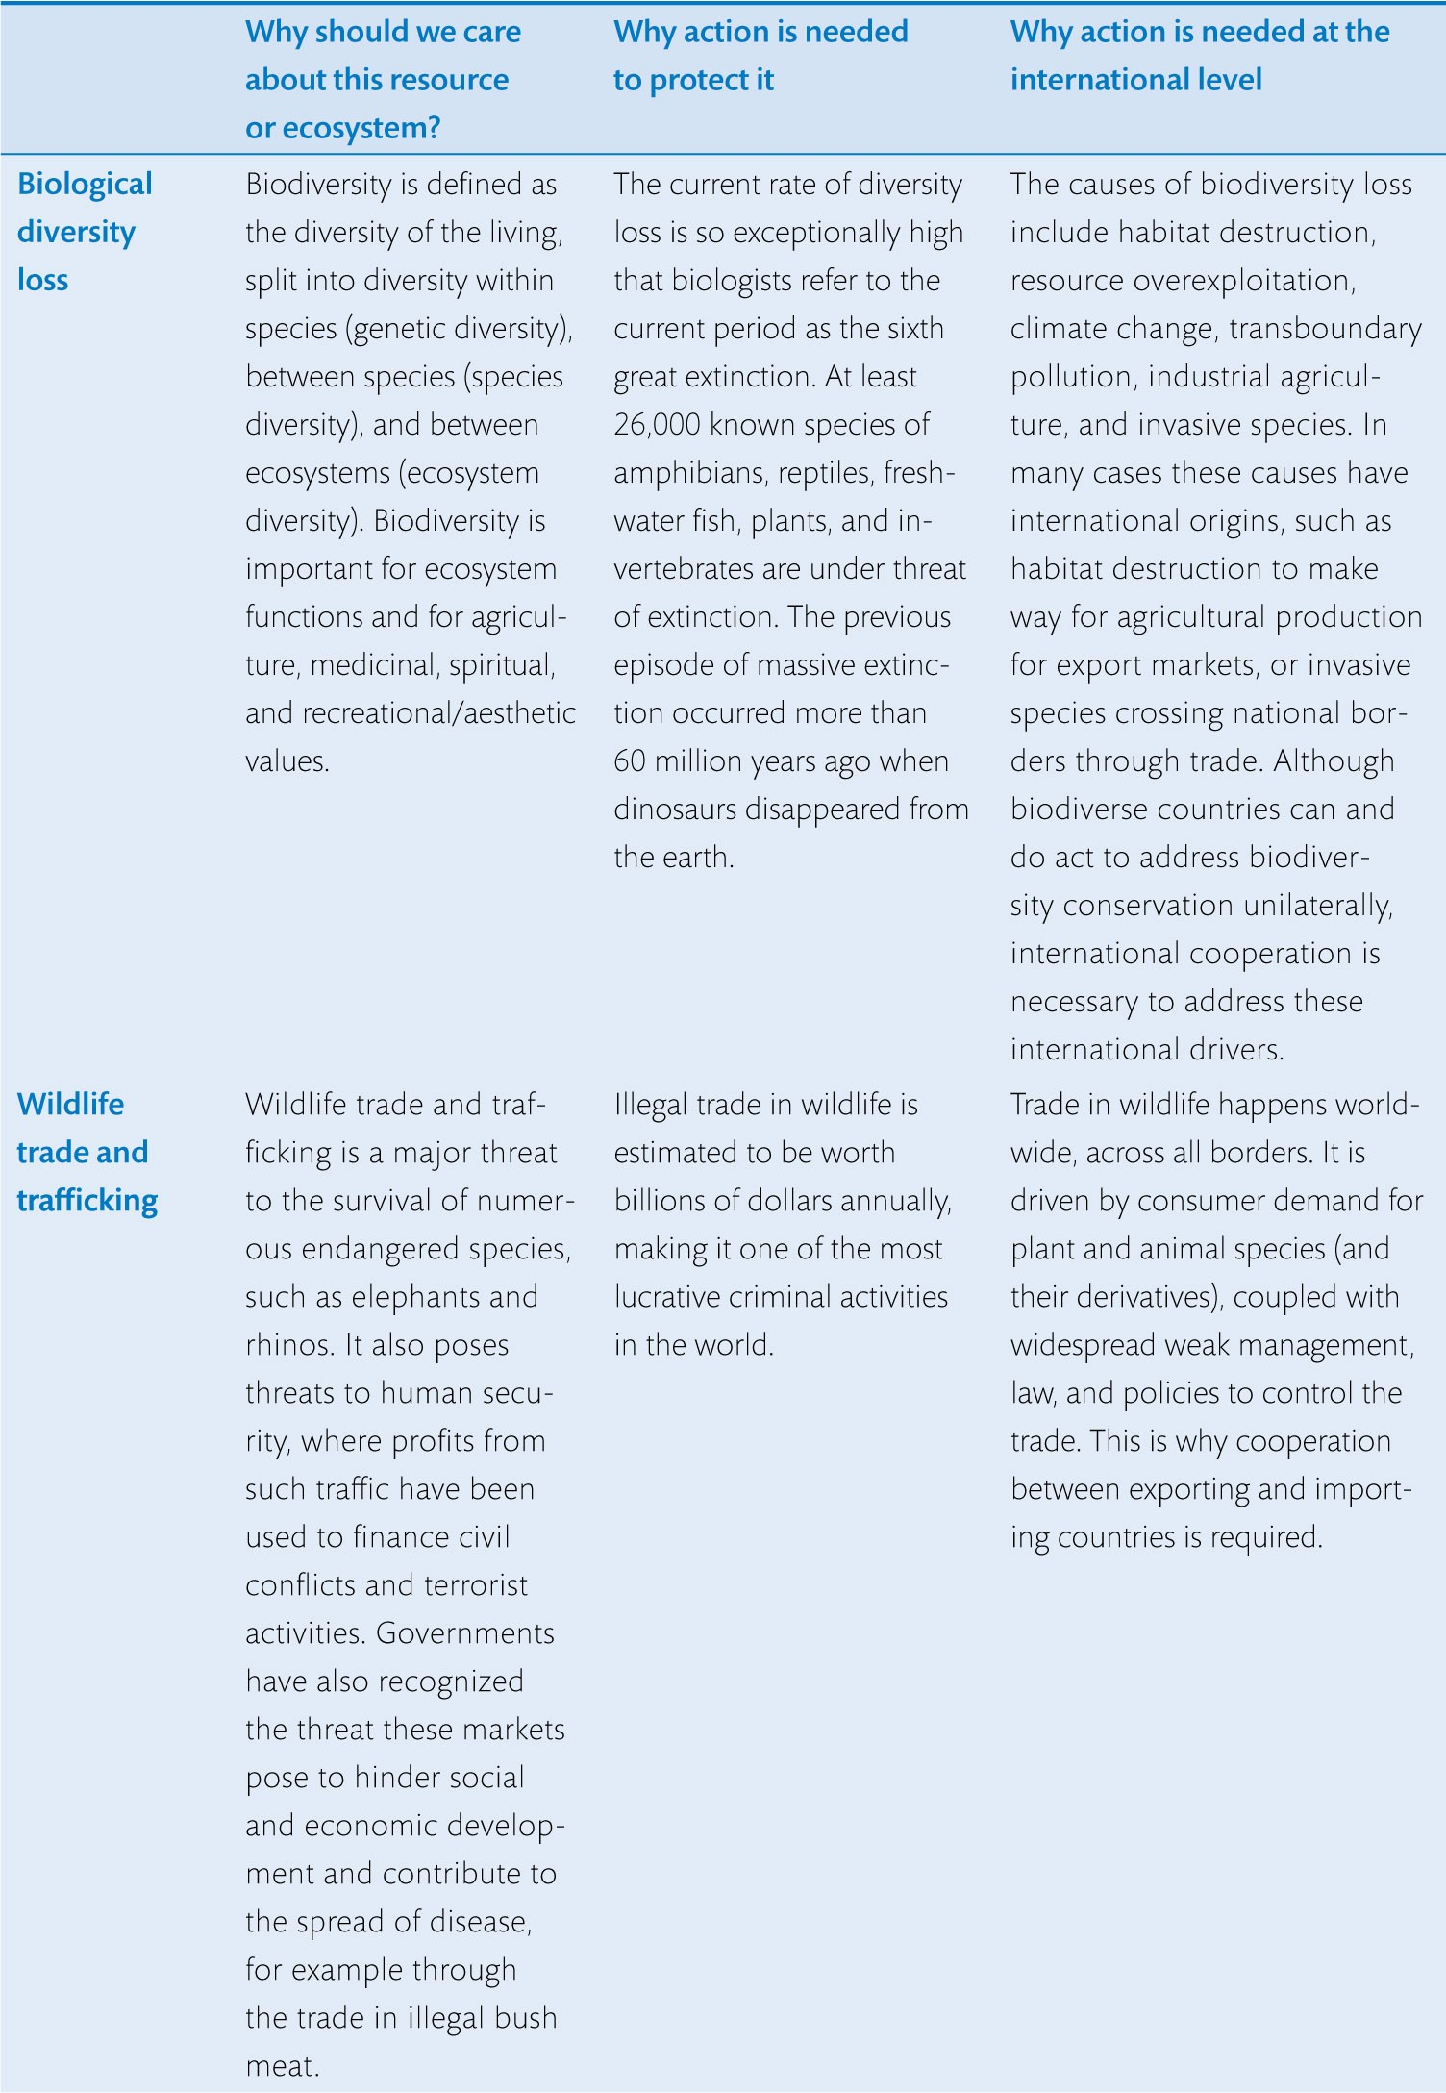
Table 0.1 Selected international environmental issues (Continued)

Slide 7
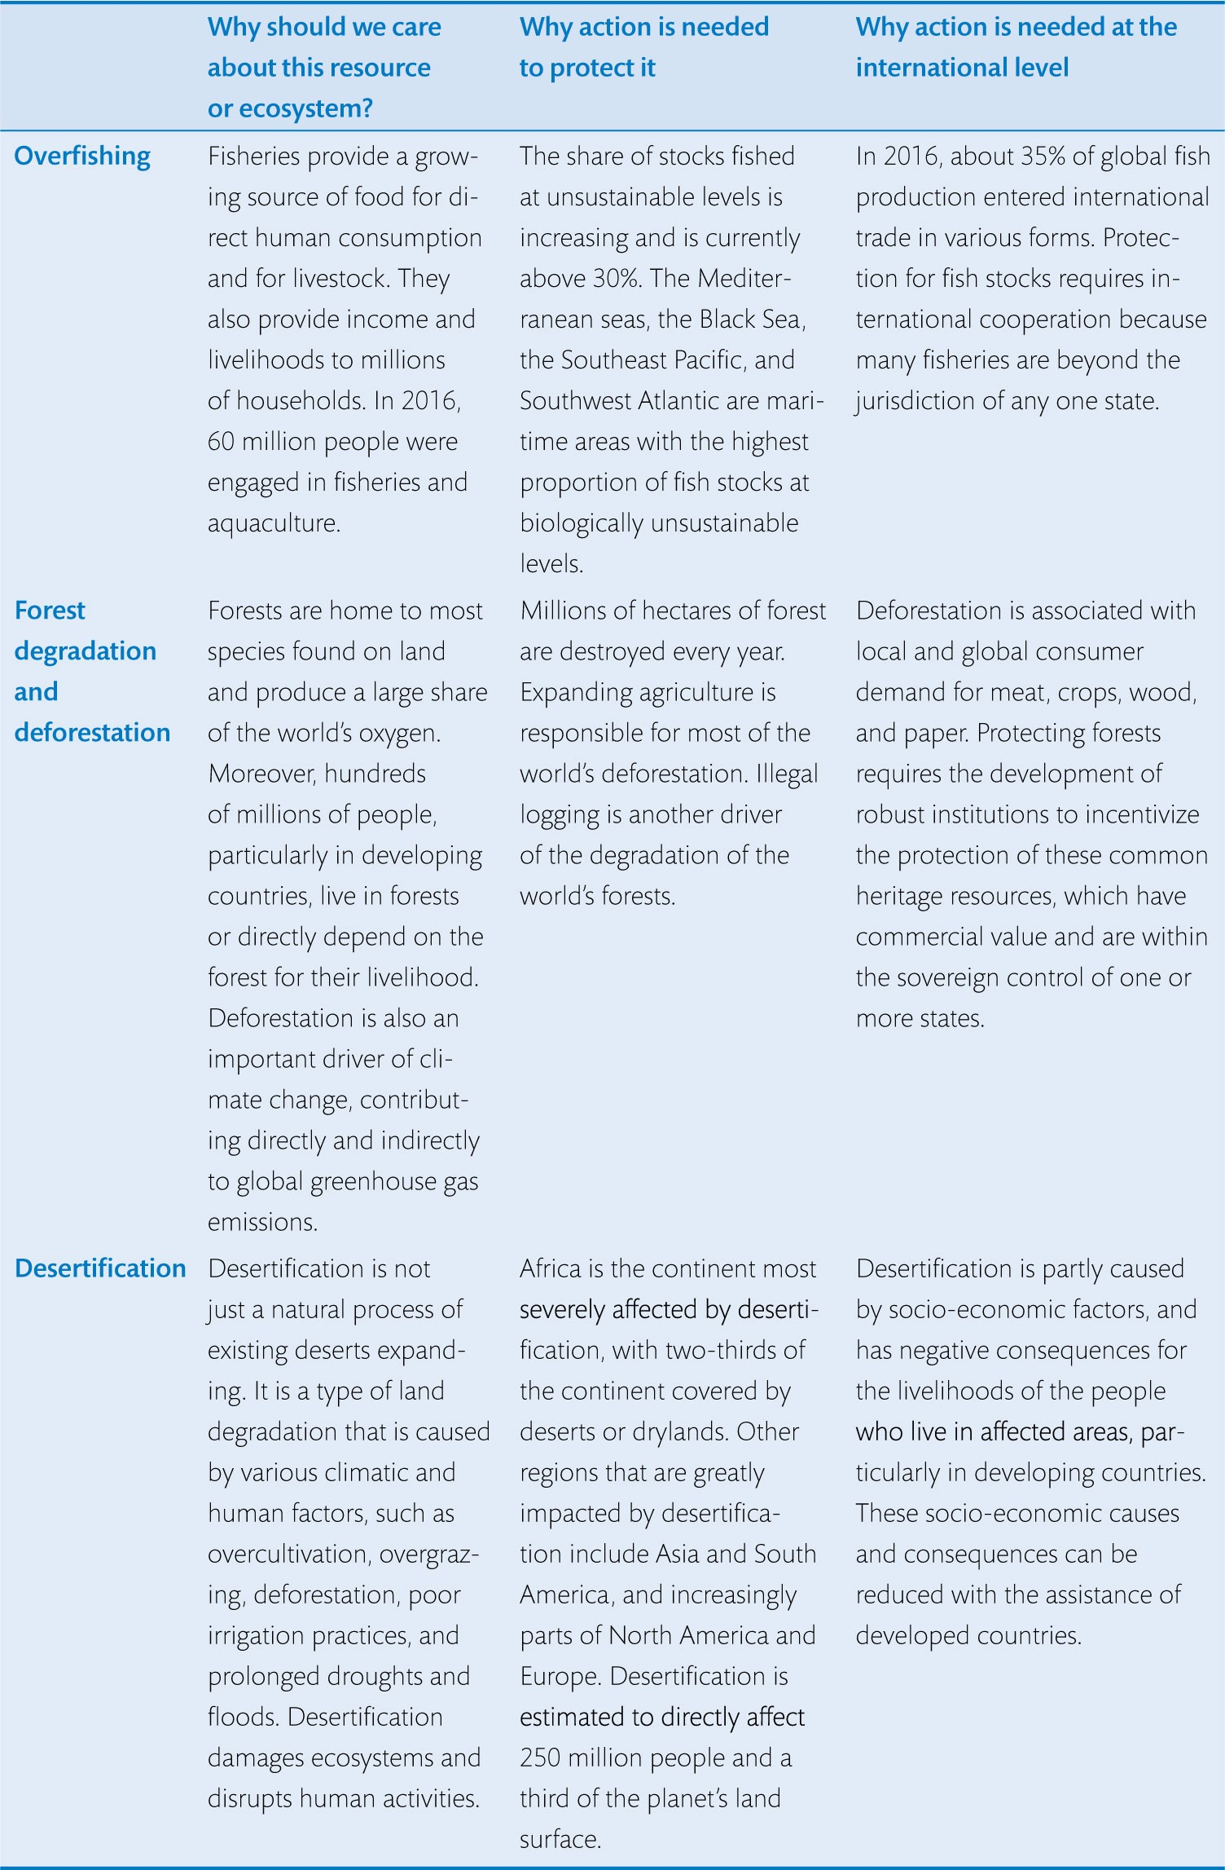
Table 0.1 Selected international environmental issues

